Slide 1





Slide 2

Table of Contents
01 Our eam
02 What’s StructForce?
03 Development Process
04 Three-Tier Architecture
05 Used programs

Slide 3




Our Team
Scrum Master
Backend Dev 1
9A
9G
Project coordination & GitHub
Algorithms & Logic layer
Backend Dev 2
Frontend Dev
9G
9A
Auth & Data layer
ImGui & UI Design

Slide 4

What’s StructForce?
StructForce is a C++ desktop application for managing personal contacts.
Secure user authentication with password hashing
Three-tier architecture with clean separation of concerns
Dark Mode and Light Mode themes
Data persistence using binary files (users.dat, contacts_*.dat)
Implements advanced algorithms: QuickSort, Linear Search, Recursion

Slide 5
Development Process
1
Brainstorming & Planning
2
Core Implementation
3
Authentication & Data Layer
4
GUI Development & Integration
5
Testing, Documentation & Deployment

Slide 6
Three-Tier Architecture
PRESENTATION LAYER
ImGui GUI • User Interface • User Interaction
LOGIC LAYER
Algorithms • Validation • Business Rules
DATA LAYER
Structures • CRUD Operations • File I/O

Slide 7

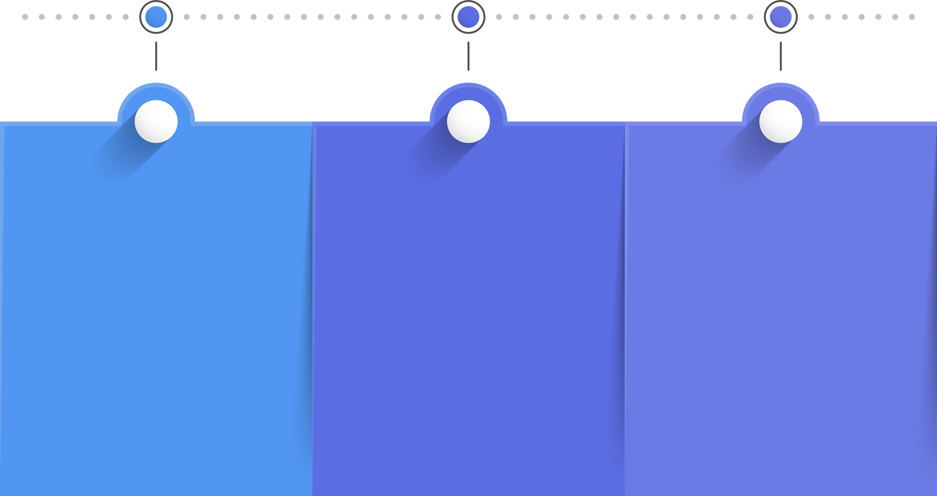
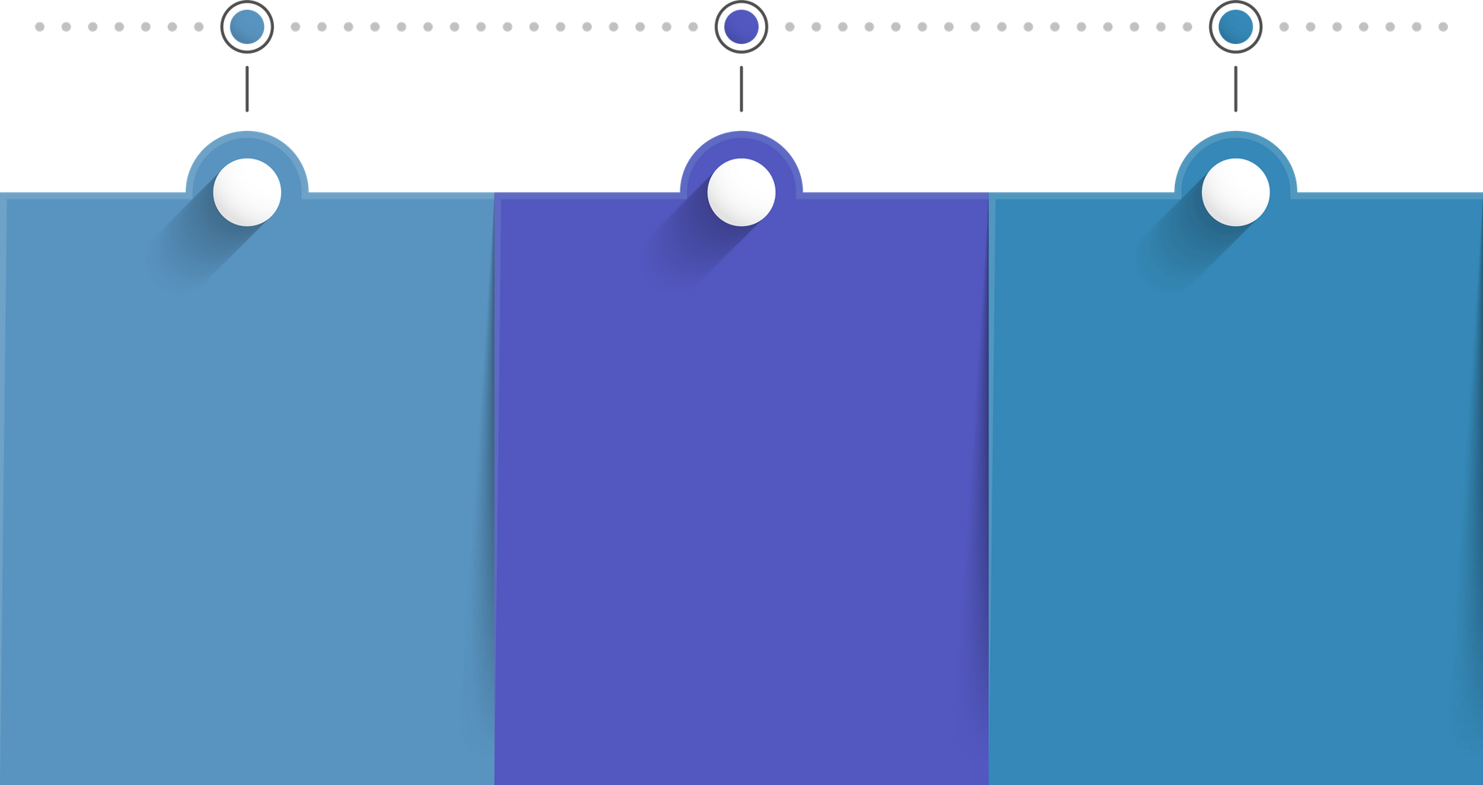


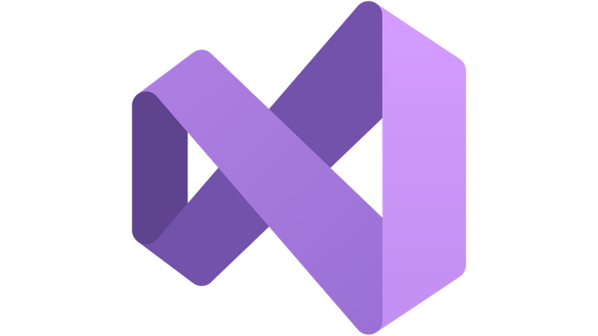
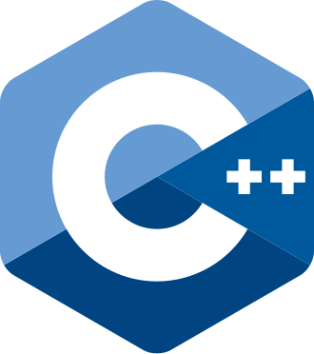





Used programs
USED PROGRAMS
Communication & Documentation
COMMUNICATION
& DOCUMENTATION
Design
code editors
Language
DESIGN
CODE EDITORS
LANGUAGE

Slide 8
Let's jump to the project

